Slide 1
Introduction to Chemical Reactions

Slide 2
At the end of this lesson, you should be able to do the following:
• | Define chemical reaction.
• | Understand that most of the things around us have been created by chemical reactions.
• | Identify the indicators of a chemical reaction having had occurred.

Slide 3
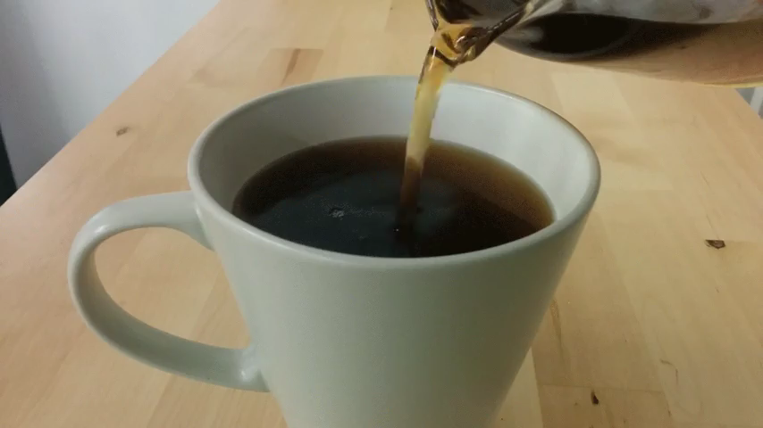
In chemical reactions, existing substances are converted into different and new substances.
Chemical reactions are a big part of modern life. Most of the materials around you have been made using chemical reactions.

Slide 4
One chemical reaction you may be familiar with is the light that is produced when you snap a glowstick.
When you snap a glowstick, you break a small capsule inside of it which contains a fluid. This mixes with another fluid already loose in the glowstick.
When they mix, they start a slow and long-lasting chemical reaction which produces light.

Slide 5
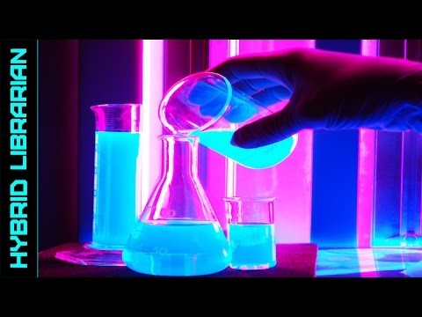

Slide 6
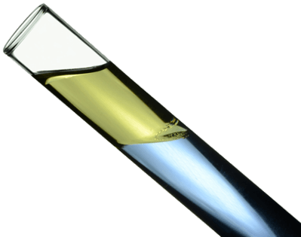
A chemical reaction does not always happen when we mix substances together.
This is because certain substances react more easily with one another than others.

Slide 7
Reaction conditions describe the relevant environmental conditions the reaction occurs in.
Some examples of reaction conditions are:
What was the room temperature?
Did you heat your reaction?
Did you expose the reaction to light?
Did the reaction require time?

Slide 8

If we were to bake a cupcake, the temperature of the oven and the time spent baking are the reaction conditions.
Other environmental conditions, like the time of day, are unimportant and are not reaction conditions.

Slide 9
While it is often easy to spot when a physical change has occurred, it is often much less obvious when a chemical change has occured.
Let's take a look at some tell-tale signs of a chemical reaction!

Slide 10
Colour change
Sometimes the product is a different colour to the reactants.
Colour change, especially to a colour which is not present in the reactants, is one general indicator of a reaction.

Slide 11
A gas is given off (as seen by bubbles or detected by smell).
This shows that a chemical reaction has occurred as the gas is a product of the reaction.
If none of the reactants were gases, the presence of gases as products indicates that they have been created in the reaction.
Bubbles are the easiest way to detect gas.

Slide 12
A solid is created.
This shows that a chemical reaction has occurred because a product (the solid) has formed, which was not there before.
We call a solid a precipitate.

Slide 13
The temperature of the reactants changes on its own.
Sometimes when a chemical reaction occurs, heat is absorbed or released in the process of the reaction occurring. This can cause the temperature of the reaction mixture to change.
So some reactions will start to feel hot or cold on their own, and some need to be heated to make the reaction happen.

Slide 14
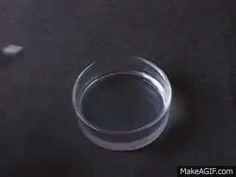
Sound or light energy is given off.
We won't explore the reasons why this can happen, but sometimes when a chemical change occurs, sound or light energy can be released.
For example, dropping potassium into water causes an explosion. In fact, most burning reactions release light.

Slide 15
To summarise, these are the indicators to show that a chemical reaction has occurred:
1. | A colour change occurs.
2. | A gas is given off (seen as bubbles or detected by smell).
3. | A solid forms (known as a precipitate).
4. | The temperature increases or decreases (without being heated/cooled).
5. | Sound or light energy is given off.

